Slide 1
CS60055: Ubiquitous Computing
Contactless Sensing
Part III: mmWave Sensing
Thanks to Argha Sen and Debjit Chatterjee for helping with the slides!

Slide 2
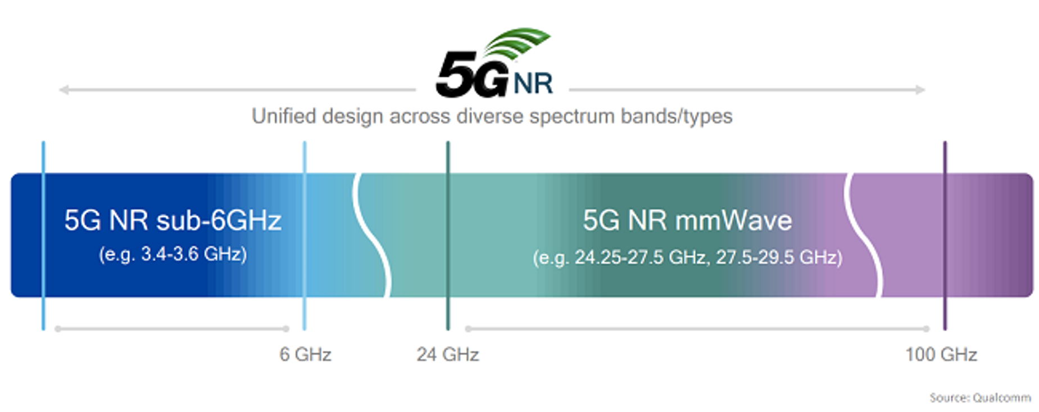
5G New Radio (NR)

Slide 3

Ubiquitous Computing over 5G
Computation
Communication
Sensing

Slide 4
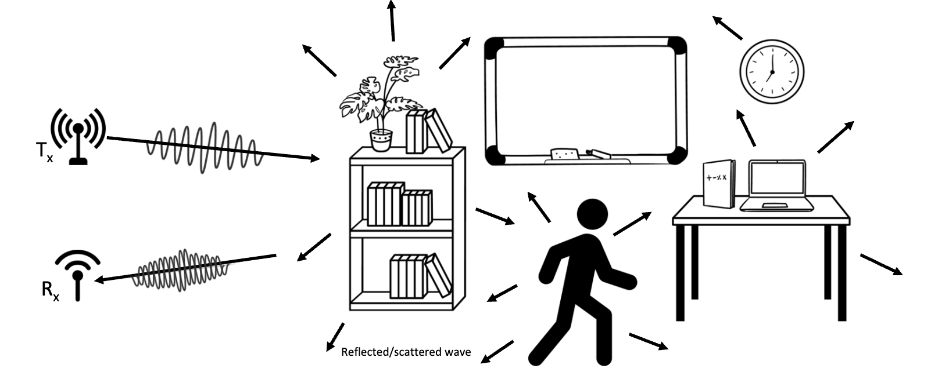
Background: How Sensing Works
Signals gets reflected from human subjects and other objects in the periphery: Explore the signal reflection properties

Slide 5
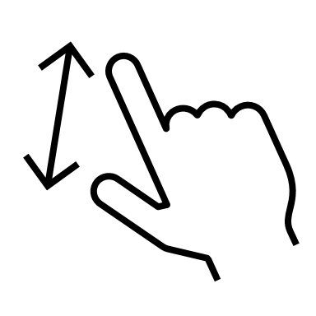








Human Activity Recognition
Source
Sensor
Feature
Inference
Signal Processing: AoA, Point-cloud, RSSI/SINR
Deep Learning based feature extraction n/w
Speech recognition
Indoor positioning
Breathing monitoring
Facial expression recognition
Gesture recognition
Localization/tracking
Gesture
Vital Signs
Presence & movement
Location

Slide 6
Various Sensing Modalities
Signal | Frequency | Key properties signifying applicability
Acoustics | 20 Hz - 20 kHz(audible) >20 kHz | Affected by acoustic interference in environment
UWB | 3.1 GHz to 10.6 GHz | Interference with sub 6 GHz Communicating Devices
Wifi | 2.4 GHz/ 5 GHz | Low Range resolution, less accuracy with CSI
mmWave | 30–300 GHz | Various commercial devices. Prominent technology of the near future
Bluetooth | 2.4GHz | Low Resolution
LoRA | 169 MHz, 433 MHz, 868 MHz and 915 MHz | Long range sensing but not apt for indoor

Slide 7
Various Sensing Modalities
Signal | Frequency | Key properties signifying applicability
Acoustics | 20 Hz - 20 kHz(audible) >20 kHz | Affected by acoustic interference in environment
UWB | 3.1 GHz to 10.6 GHz | Interference with sub 6 GHz Communicating Devices
WiFi | 2.4 GHz/ 5 GHz | Low Range resolution, less accuracy with CSI
mmWave | 30–300 GHz | Various commercial devices. Prominent technology of the near future
Bluetooth | 2.4GHz | Low Resolution
LoRA | 169 MHz, 433 MHz, 868 MHz and 915 MHz | Long range sensing but not apt for indoor

Slide 8
A Vast Literature on RF Sensing
Wifi
Acoustics
UWB
mmWave
Presence Detection
Counting crowd
Breathing monitoring
Heartbeat monitoring
Temperature Monitoring
Breathing monitoring
Gesture recognition
Speech recognition
Heart rate monitoring
Indoor positioning
Heart rate monitoring
Speech recognition
Hand gesture recognition
Eyelid movement
Respiration Monitoring
Multi-user breathing monitoring
Fire detection
Facial expression recognition
localization/tracking
Eyelid movement
Hand gesture recognition
Gesture recognition
Fall detection
Gait Abnormality Detection
Localization/tracking
Smoking detection
Fall detection
Mouth movement
Gait identification
Keystroke Recognition
Emotion detection
Traffic Monitoring
Heart beat monitoring
Driver Fatigue Detection
Parking space monitoring
LOS detection
Presence detection
Metal detection
Parking space monitoring
Finger Gesture Recognition
Gas monitoring
Multi-User Gesture Recognition
Human Identification

Slide 9
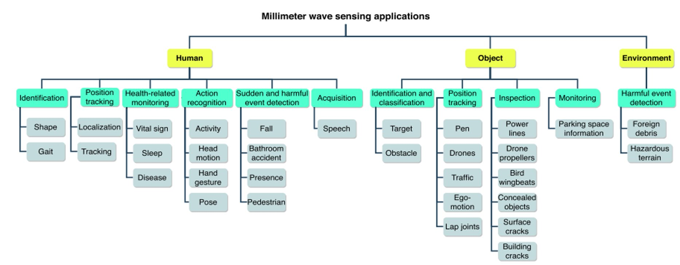

mmWave Sensing – A Vast Literature

Slide 10
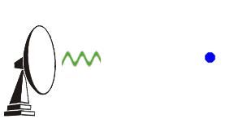
mmWave Sensing
mmWave sensing follows the radar principles
Uses various modulation schemes widely used in commercial radars
  Phase modulation: Use the phase difference to capture the AoA
  Continuous Wave modulation: Uses a constant frequency carrier; cannot measure range as the carrier signal is unmodulated
  Frequency Modulated Continuous Wave (FMCW)

Slide 11
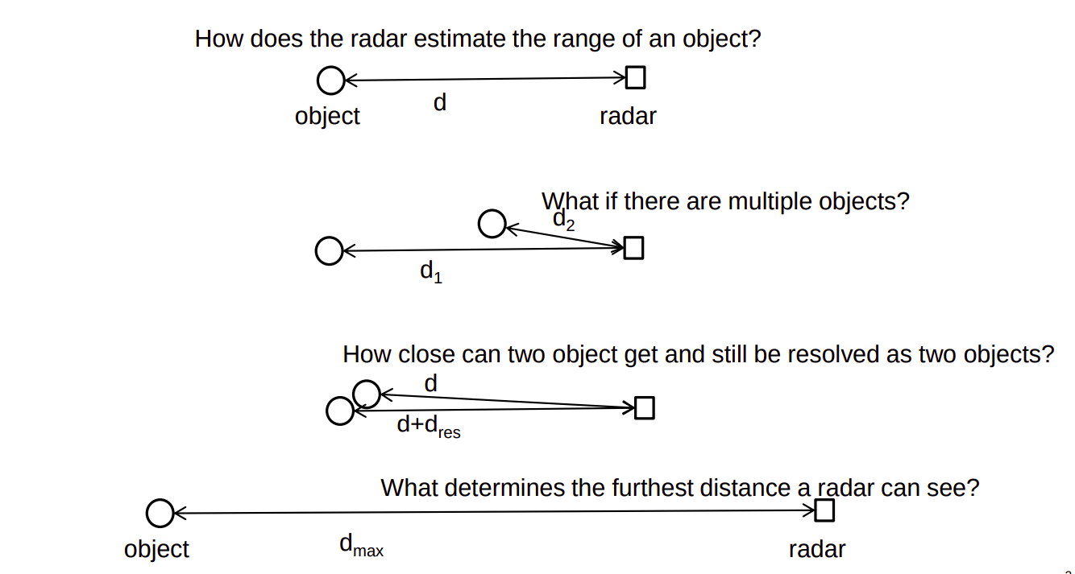
FMCW Radars
The basic objectives of a radar are the followings:

Slide 12
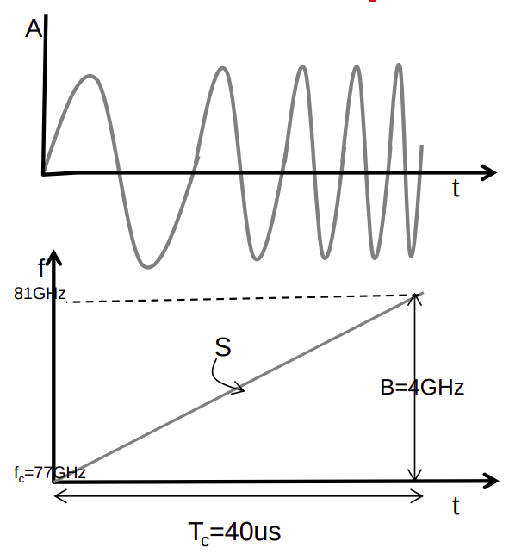
FMCW Radars
FMCW radar transmits chirps
A chirp is characterized by a fc, B and T_{c}.
The Slope (S) defines the rate at which the chirp ramps up.

Slide 13
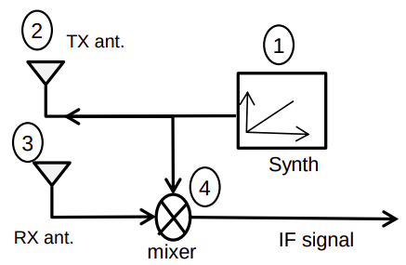
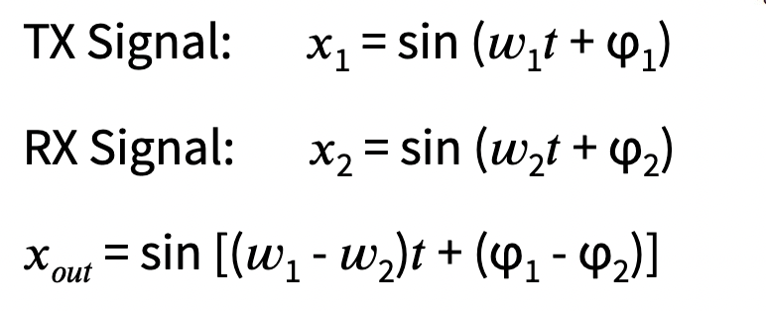
FMCW Radars
FMCW radar transmits chirps
A chirp is characterized by a fc, B and T_{c}.
The Slope (S) defines the rate at which the chirp ramps up.

Slide 14
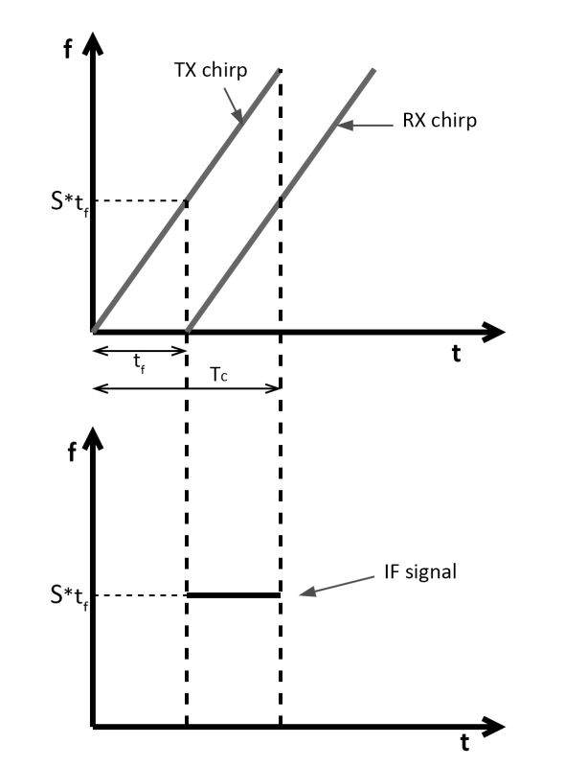
FMCW Radar: The IF Signal
The Rx is the replica of the Tx shifted in time t_{f} = 2d/c
Tx and Rx has the same linear modulation, the difference is a constant tone
  Equals to the round trip delay multiplied by the slope of the signal
  Slope S = B/T_{c} , B is the bandwidth
  The resultant frequency is called the intermediate frequency (IF)

Slide 15
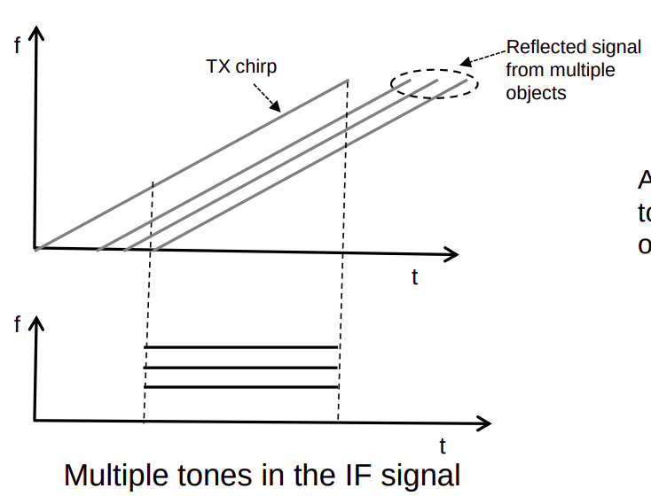
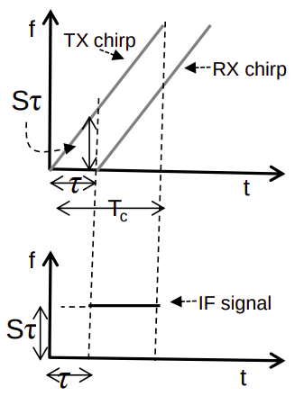
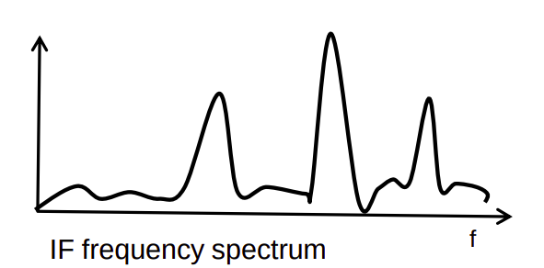
FMCW Radar: The IF Signal
The frequency difference of the TX-chirp and RX-chirp.
Object in front of the radar produces an IF signal with a constant frequency tone.
The frequency of this tone is f_{IF} = S.τ = S.2d/c
τ = 2d/c is the round-trip time

Slide 16
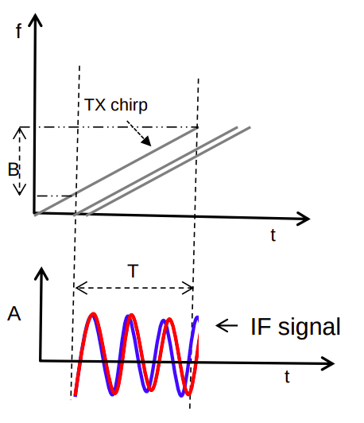
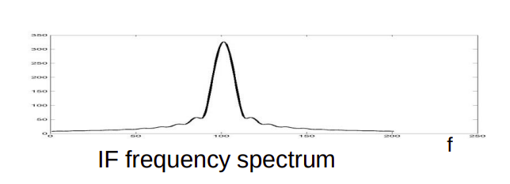
FMCW Radar: Range Resolution
Range Resolution: Ability to resolve two closely spaced objects.
When the two objects are too close that they show up as a single peak in the frequency spectrum.
  The two objects can be resolved by increasing the length of the IF signal.

Slide 17
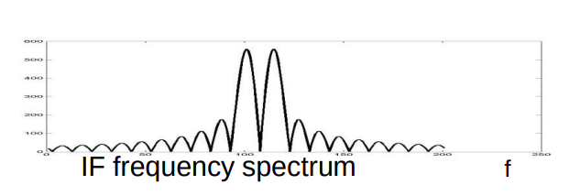
FMCW Radar: Range Resolution
Range Resolution: Ability to resolve two closely spaced objects.
When the two objects are too close that they show up as a single peak in the frequency spectrum.
This also proportionally increases the bandwidth (as we need to increase the chirp duration)!
Thus increasing the bandwidth provides better resolution

Slide 18
FMCW Radar: Range Resolution
Range Resolution: Ability to resolve two closely spaced objects.
When the two objects are too close that they show up as a single peak in the frequency spectrum.
Increasing the length of the IF signal?
This also proportionally increases the bandwidth!
Thus intuitively: Greater the Bandwidth => better the resolution.
To resolve two different tones in the frequency spectrum, they must be spaced more than 1/T, where T is the window duration. In this case, T equals to T_{c}.

Slide 19
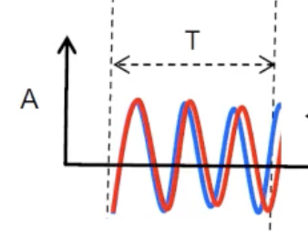
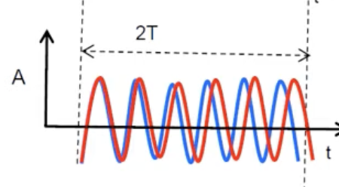
An Important Observation from FFT
To resolve two different tones in the frequency spectrum, they must be spaced more than 1/T, where T is the window duration – Why?
We often perform the Fourier transform on finite window (duration T), as we cannot analyze an infinitely long signal
Frequency Resolution: The smallest frequency difference that can be distinguished in the Fourier-transformed signal

Slide 20
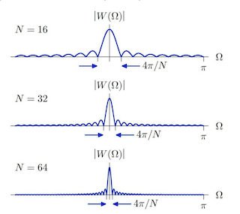
An Important Observation from FFT
Frequency Resolution: The smallest frequency difference that can be distinguished in the Fourier-transformed signal
  The sine waves or tones in the signal are transformed into peaks in the frequency domain.
  Each tone, after the Fourier transform, results in a spread of energy across several frequency bins due to the finite window.
  For two tones to be resolved, the distance between their frequencies must be larger than the spread of each tone, which is approximately 1/T

Slide 21
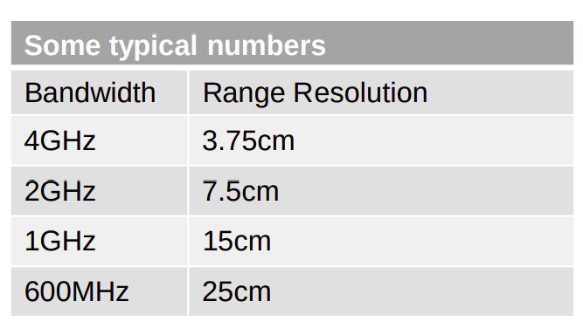

FMCW Radar: Range Resolution
Range Resolution: Ability to resolve two closely spaced objects.
When the two objects are too close that they show up as a single peak in the frequency spectrum.
Increasing the length of the IF signal?
This also proportionally increases the bandwidth!
Thus intuitively: Greater the Bandwidth => better the resolution.
To resolve two different tones in the frequency spectrum, they must be spaced more than 1/T, where T is the window duration. In this case, T equals to T_{c}.
The minimum range resolution can be computed as:

Slide 22
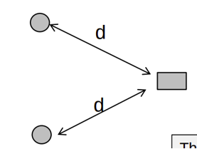
Equidistance Objects
Two objects are equidistant from the radar. How will the range-FFT look like?

Slide 23
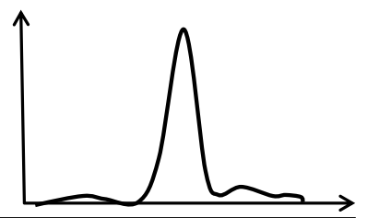
Equidistance Objects
Two objects are equidistant from the radar. How will the range-FFT look like?

Slide 24
Equidistance Objects
Two objects are equidistant from the radar. How will the range-FFT look like?
How do we separate these two objects?

Slide 25
Equidistance Objects
Two objects are equidistant from the radar. How will the range-FFT look like?
How do we separate these two objects?
The phase information helps!

Slide 26
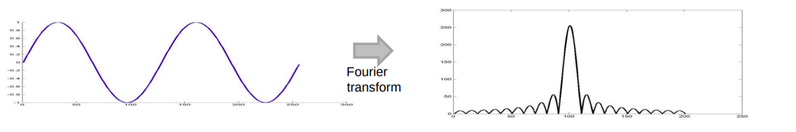
FMCW Radar: Phase of the IF Signal
Fourier Transforms: A sinusoid in the time domain produces a peak in the frequency domain.
The signal in the Frequency domain is complex (i.e., each value is a phasor with an amplitude and a phase)

Slide 27
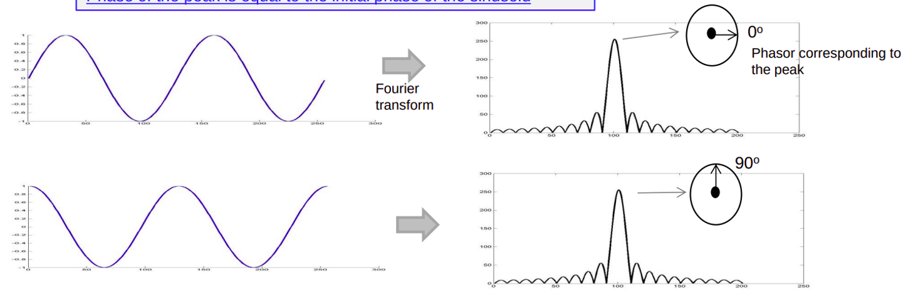
FMCW Radar: Phase of the IF Signal
Fourier Transforms: A sinusoid in the time domain produces a peak in the frequency domain.
The signal in the Frequency domain is complex (i.e., each value is a phasor with an amplitude and a phase)

Slide 28
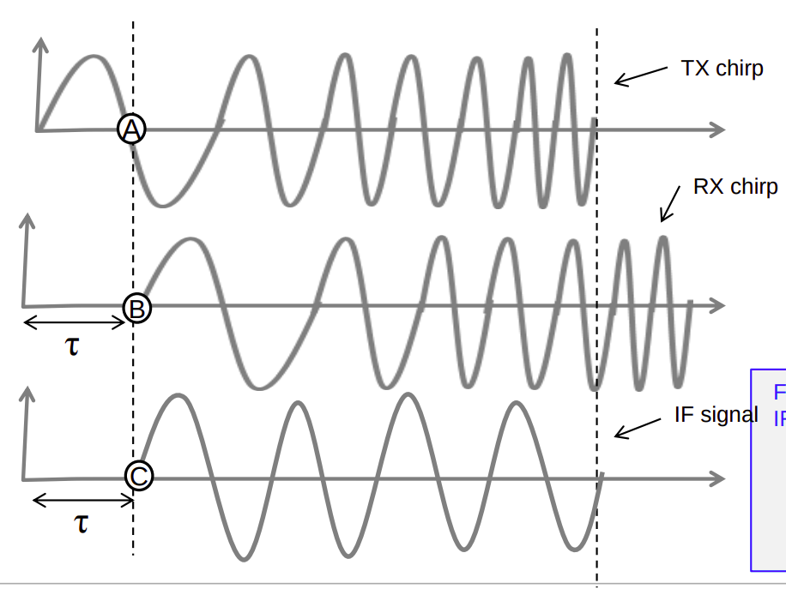
FMCW Radar: Phase of the IF Signal

Slide 29
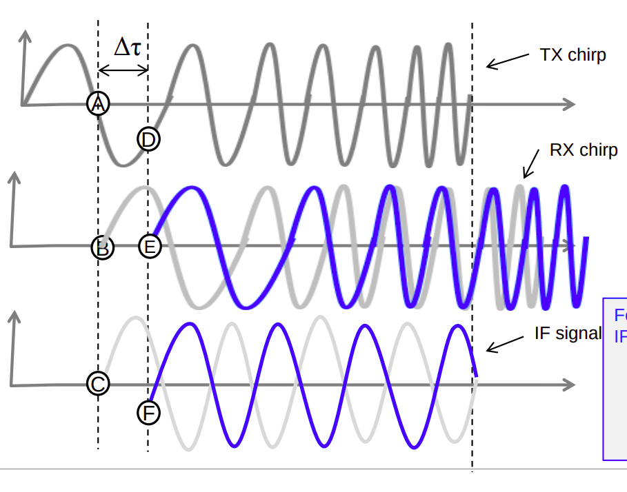

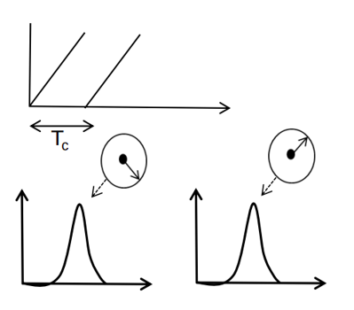
FMCW Radar: Phase of the IF Signal
Phase difference between (A and D) or (C and F) is

Slide 30
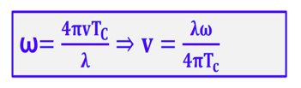
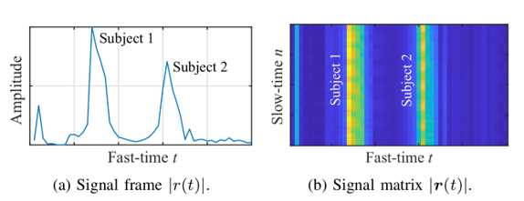
FMCW Radar: Phase of the IF Signal
Phase difference between (A and D) or (C and F) is

Slide 31
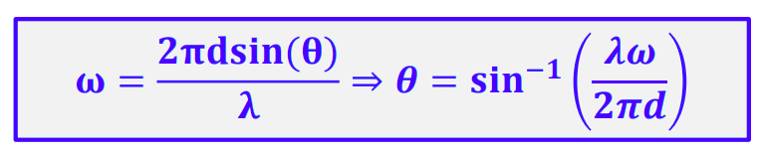
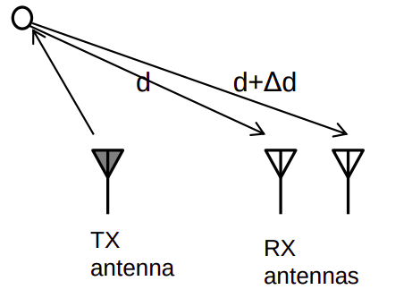
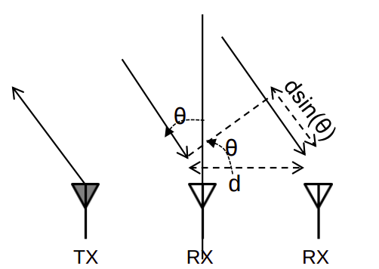
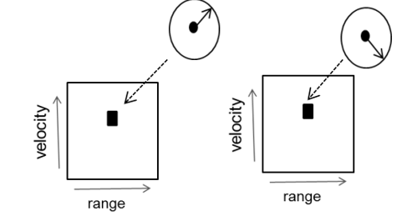
FMCW Radar: AoA Estimation
TX antenna transmits a frame of chirps
The 2D-FFT corresponding to each RX antenna will have peaks in the same location but with differing phase.
The measured phase difference (ω) can be used to estimate the angle of arrival of the object.

Slide 32
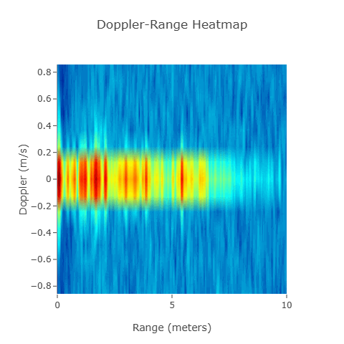
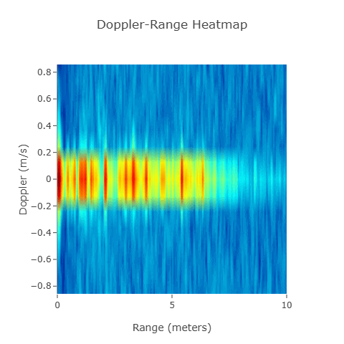
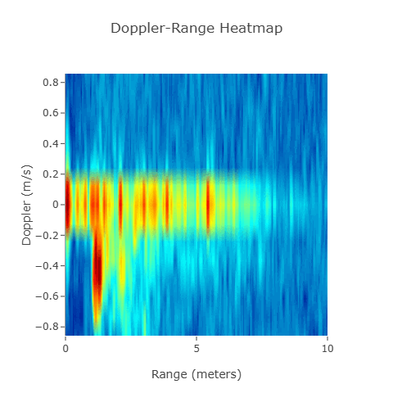
Visualizing and Analyzing mmWave Radar Data
Rangle-Doppler heatmap:
  Represents the detected objects' distances (range) and relative velocities (Doppler shift); each point corresponds to a unique combination of range and Doppler values
  intensity of each point indicates the strength of the reflected signal (probability that an object is being present in that range)

Slide 33
Visualizing and Analyzing mmWave Radar Data
Rangle-Doppler heatmap:
  Represents the detected objects' distances (range) and relative velocities (Doppler shift); each point corresponds to a unique combination of range and Doppler values
  intensity of each point indicates the strength of the reflected signal (probability that an object is being present in that range)
Why do we see a high intensity at zero-doppler?

Slide 34
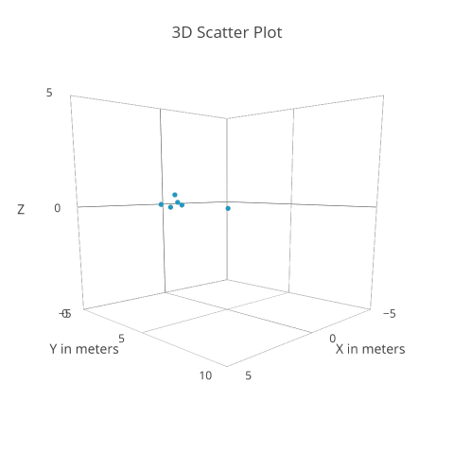
Visualizing and Analyzing mmWave Radar Data
Point Cloud Data (PCD):
  A collection of data points in 3D space that represents the positions of objects detected by the radar (A point where a radar reflection is detected)
  Generated from distance (range), relative velocity (Doppler) and AoA -- Each detected point is mapped to a specific 3D coordinate based on range, angle, and Doppler information.

Slide 35
Analyzing mmWave Data
1D FFT (Range FFT) to extract the Range Information
  Use the beat frequency (FFT over the IF signal) to compute the range bins
  Each peak in the range FFT corresponds to an object at a specific distance
2D FFT across Chirps (Doppler FFT)
  A second FFT is performed across the slow time axis, which corresponds to the sequence of chirps
  Reveals the Doppler frequency shift caused by the relative motion of objects with respect to the radar
Angle FFT
  A third FFT at the spatial dimension (across antennas) to capture the AoA

Slide 36

MARS
Continuous Multi-user Activity Tracking via Room-Scale mmWave Sensing
ARGHA SEN, ANIRBAN DAS, SWADHIN PRADHAN, SANDIP CHAKRABORTY
IIT KHARAGPUR
ACM/IEEE IPSN 2024

Slide 37
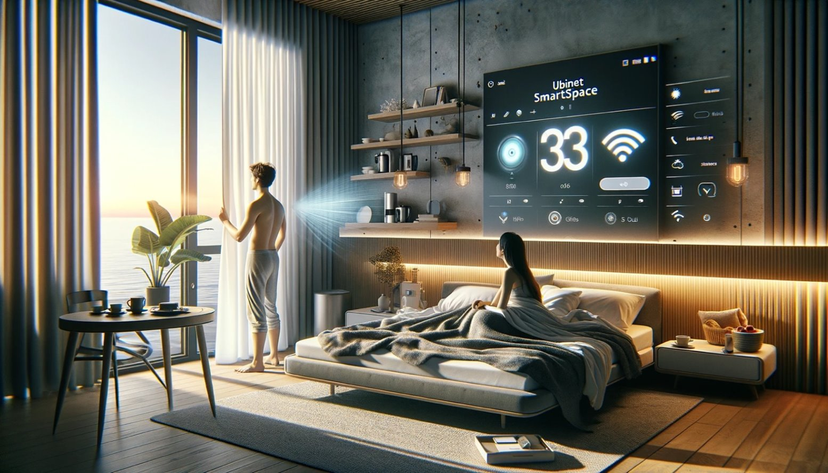
Your Home Knows You Well
Generated through GPT-4

Slide 38
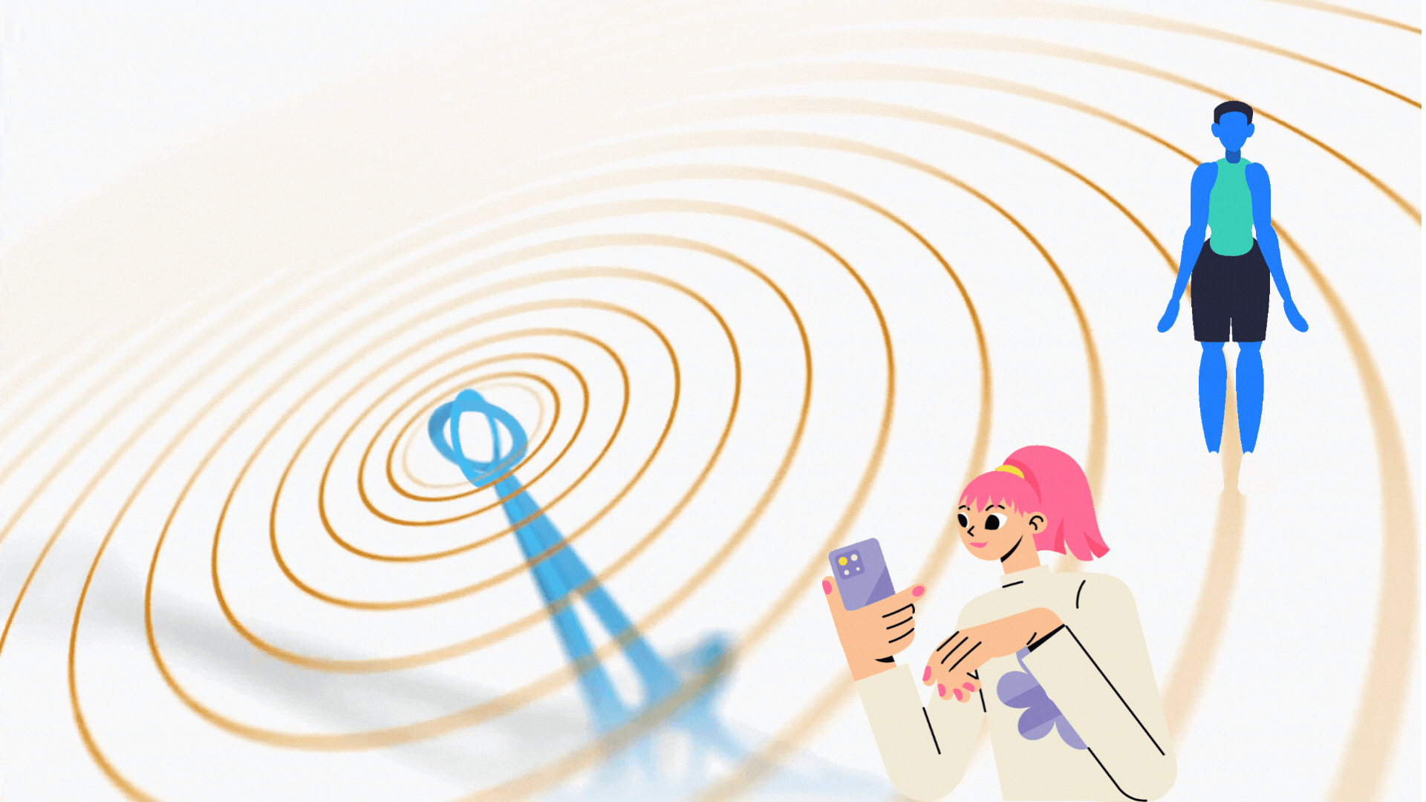
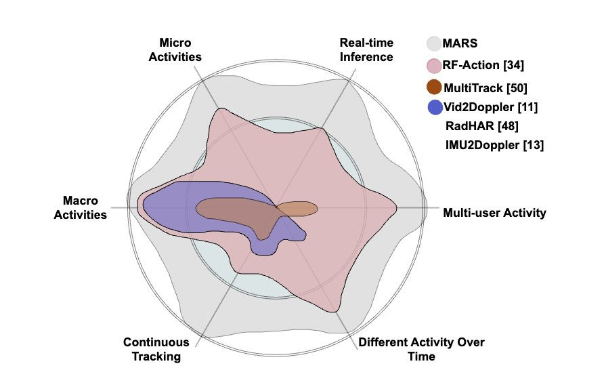
Requirements
Continuous subject tracking
Monitoring multiple subjects
Monitoring different activities over time
Real-time inference of activities
Multi-activity support
  Both in micro-scale as well as macro-scale
Notes:
Let us start with the key requirements we outlined for MARS. These requirements are essential for achieving our goals and ensuring a robust system.
The Core Needs
Continuous Subject Tracking: We need to track subjects throughout the monitoring process in a continuous fashion rather than an opportunistic way.
Monitoring Multiple Subjects: Our system must be able to handle scenarios with more than one person present, following each individual's activities.
Monitoring Different Activities Over Time: The system should be able to identify a wide range of activities and track how they change over time.
Real-Time Inference of Activities: We need activity recognition with a considerable delay, allowing for a near-instantaneous understanding of what's happening.
Advanced Capabilities
Multi-Activity Support: The system should be able to recognize and handle situations where multiple individuals perform different activities.
Micro-Scale and Macro-Scale Monitoring: We need the system to function effectively on both small and large scales, identifying subtle movements and broader actions.
We can even quickly compare where MARS stands with the existing works in this direction to address the above-mentioned aspects!

Slide 39
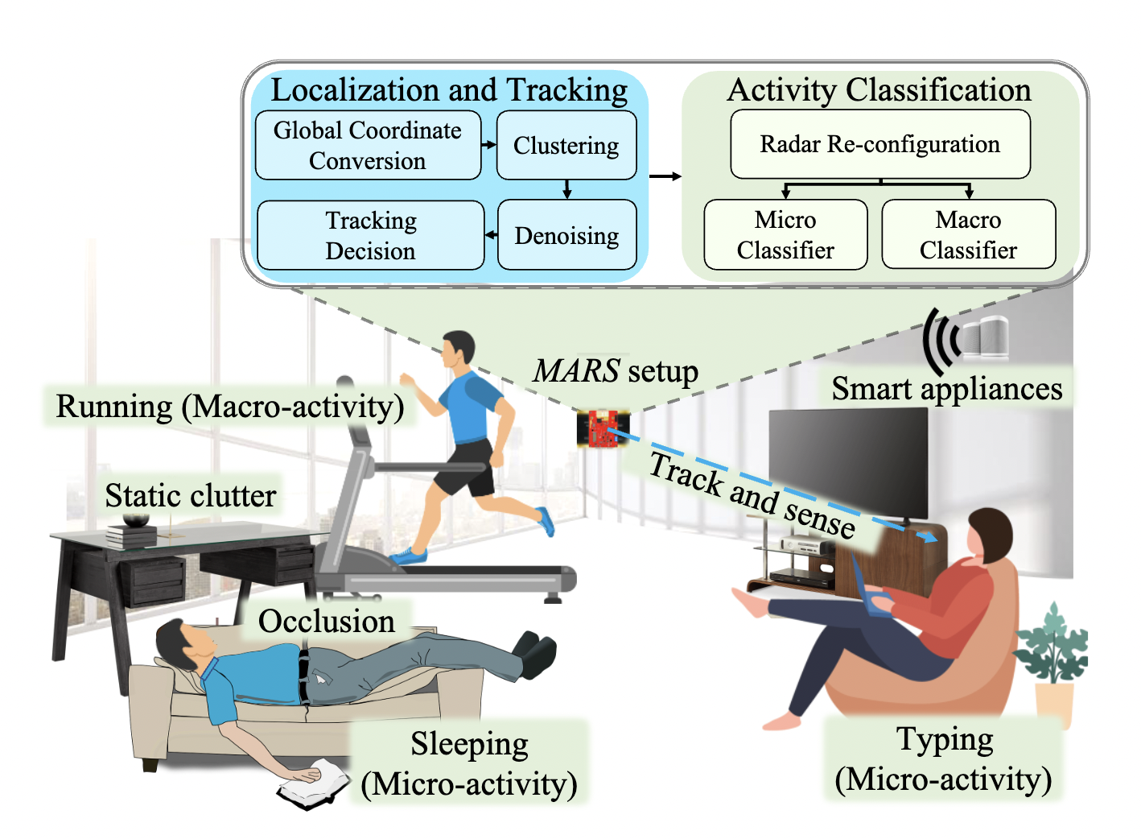
The Broad Vision Towards a Feasible Solution

Slide 40
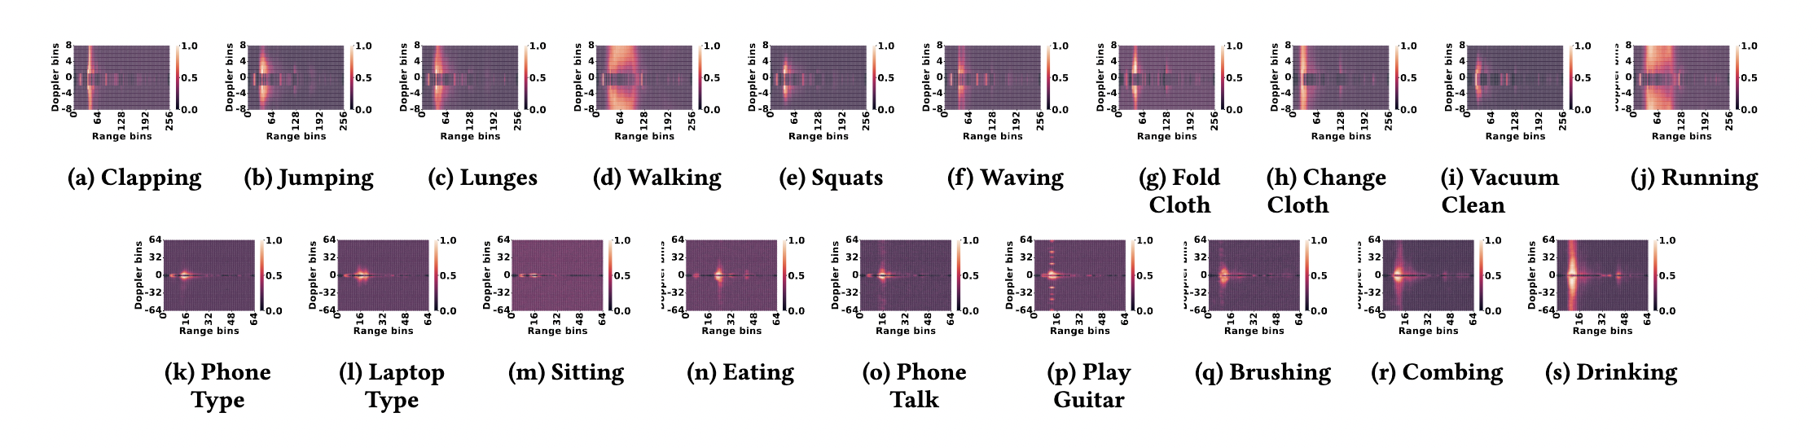
Which Activities Can be Sensed?
We primarily consider
  Activities of Daily Living (ADLs)
  Instrumental Activities of Daily Living (IADLs)
  Exercises
Need different doppler resolutions for macro (-8 to 8) and micro (-64 to 64) activities to separate
The temporal changes are also important
  Running has much faster temporal changes than walking

Slide 41
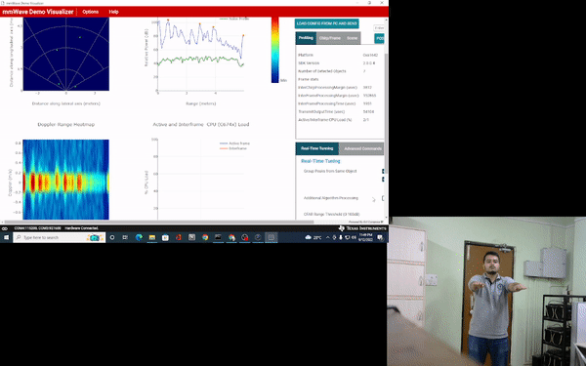


Examples: Exercise

Slide 42

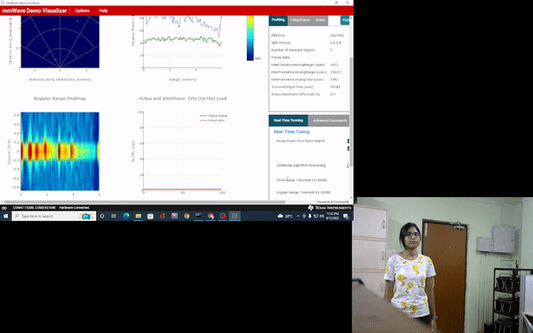
Examples: Different Jumping Activities

Slide 43
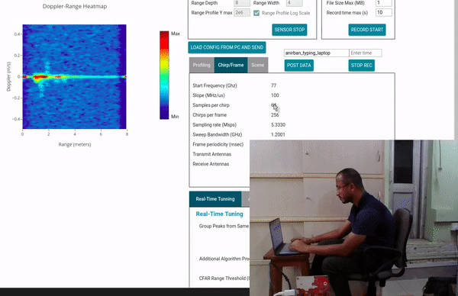
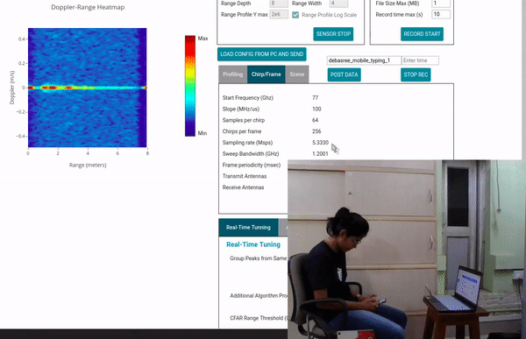
Examples: Micro Activities
Using Phone
Using Laptop

Slide 44
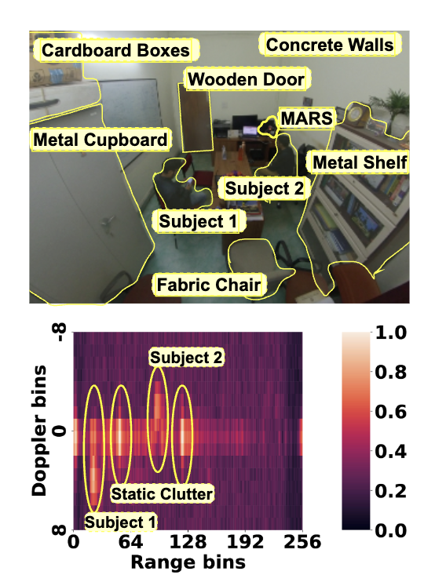
Impact of Static Clutters
Any object which are stationary but can reflect the mmWave signals
  Walls, furniture, etc.
We observe multiple peaks at the range bins
Static clutters produce a higher magnitude along the zero doppler axis
  Signifying near-zero or no movements

Slide 45
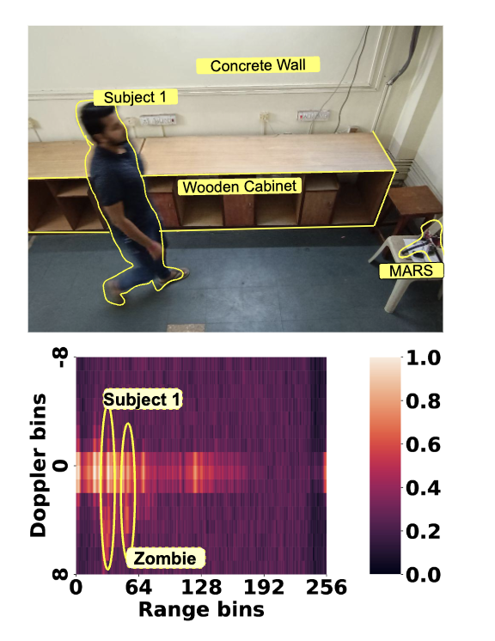
Impact of Non Line of Sight (NLoS)
The subject stands near the wall and then
makes some movements
  The NLoS reflections from the wall creates a
  signature on the range-doppler heatmap
  (we call them as zombie)
Zombie has a lower peak than the original
subject
  Need a method to extract the signatures from the
  zombies

Slide 46
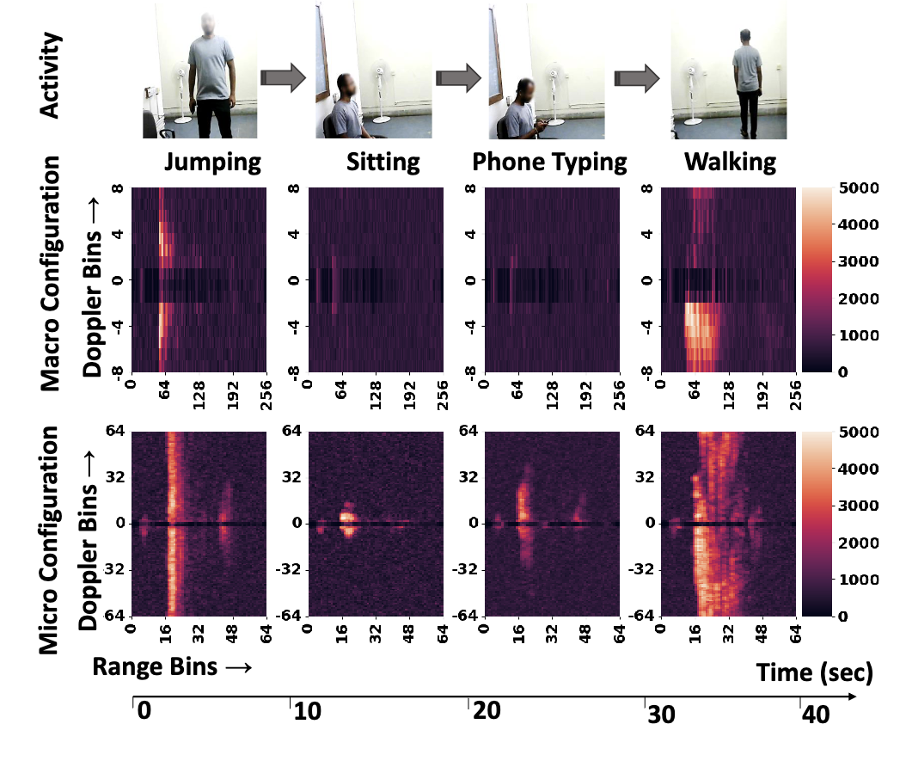
Radar Configuration
Different types of activities are detectable at different doppler resolutions!

Slide 47
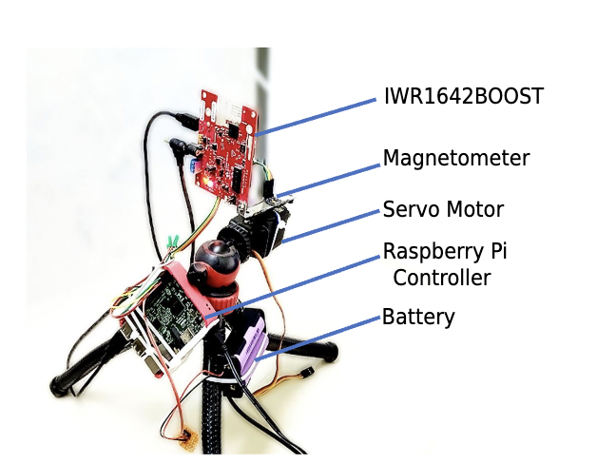
MARS (Multi-user Activity Tracking via Room-scale Sensing)
Mount the radar on top of a servo
  A magnetometer to track the movement
  of the servo
Lifecycle of the radar
  Detect a user from point-cloud data
  Localize and track the user
  Check the macro activity
  Switch the radar configuration
  Check the micro activity
  Switch the radar configuration
Notes:
we mitigate the issue of the field of view with the help of a servo motor that changes the orientation of the radar opportunistically rather than in a continuous fashion.
We can now summarize the lifecycle of MARS by stating the following steps:
We leverage the point cloud data generated by the radar to detect individual subjects in the surrounding environment.
We localize and track individual subjects using the point cloud data
We also rely on the point cloud data to check whether a subject is performing macro or micro scale activity.
Accordingly we switch the radar configuration dynamically to better capture the signature of a specific activity type.
And finally we identify the activity being performed.

Slide 48

Point and Track with Configuration Switching
Notes:
This slide shows MARS in action, when two subjects are being tracked and monitored by MARS by opportunistically changing the orientation of the radar.

Slide 49


MARS System Architecture
Localization and Tracking Pipeline
  Isolate subjects from static clutters (using zero doppler)
  Rotating the radar changes the coordinates of the point clouds: Set up a global reference coordinate with respect to the magnetometer
Notes:
As the sensor changes its orientation, MARS uses a magnetometer to keep the track of the subjects with reference to a global coordinate system.

Slide 50

MARS System Architecture
Tracking Multiple Subjects: Use DBSCAN to cluster the pointcloud data
  Compare two clusters to check whether a new subject has been introduced in the system
Notes:
And to track multiple subjects, MARS clusters the point cloud data which helps it to isolate individual subjects and also their path of movement as shown. However, it is obvious that there could be often scenarios when multiple subjects cross each other’s path.

Slide 51

Handling Blind Spots
Two user crosses each other, creating blind spots
We use a Recursive Kalman Filter (RKF) to track the subjects movement states continuously
  Estimate when the actual Point Cloud Data (PCD) is unavailable due to occlusion
Notes:
MARS mitigates that particular problem as well. In this case a Kalman Filter was used for effectively, for continuously tracking the path of movement of individual subjects.

Slide 52





The High Level Processing Pipeline
Capture PCD and cluster the PCD to infer the subjects
Rotate the servo when a subject moves out of the main lobe of the radar
Apply Kalman Filter to estimate the subject coordinates for the missing values
Walking/Running
Random Forest Classifier on the PCD
Use 2D CNN to classify the activity levels (separate classifiers for macro and micro)
Extract non-zero doppler range bins and stack 1sec data at different (macro and micro) configurations
Static and Performing some activities
Notes:
Finally, we give the high level processing pipeline of MARS. So it starts with collecting the point cloud data then adjust the orientation of the radar whenever a subject moves out of the fov of the radar. Track the subject, compensate the missing values using kalman filter predictions. Classify the pointcloud data as general walking - running or a micro/ macro scale activity. Based on the type of activity identified, we switch the radar configuration as motivated earlier and capture the non-zero doppler range bins for 1 second data. MARS then invokes a classifier trained with micro or macro scale activities and eventually estimate the activity being performed. The detailed

Slide 53


Implementation and Testing
The processing pipeline has been
implemented on a Raspberry Pi
We experimented over three
different rooms of different sizes
7 subjects (3 female, 4 male)
Notes:
While implementing, we study, can we make MARS a portable and easily deployable solution? We implement the complete processing pipeline of MARS on a Raspberry Pi. Our evaluation environments considers three different rooms with unique set of characteristics such as size of the room, No. of objects present, size of the objects, material of the objects, LOcation of the objects etc. We also evaluate with different subjects as stated. The macro and micro configuration as mentioned earlier were chosen with the following parameters identified empirically.

Slide 54

Accuracy vs Response Times
Single User
Multi User (N=3)
Perform different activities over time
Each user performs different activities, no activity switching over time
Notes:
In comparison to the baselines, We consider different scenarios to evaluate -- the first one is single subject doing, multiple activities over time denoting Temporal activity diversity. As shown in the figure, MARS takes the least response time in inferring the activities with the highest accuracy in comparison to the baselines.
We observe that the response time for the first activity takes approx 2 sec, which involves the bootstrap time to denoise and cluster the data for localizing the subject. When a configuration switch is necessary (macro to micro or vice versa), the average response time is approx 3.14 seconds. Without a configuration switch, the average response time is approx 1 seconds. THe primary cause that challenges the baselines to achieve this performance is extended frame stacking or longer classifier inference time impacting response the time. RadHAR and Vid2Doppler show poor performance as they are built focused on macro activities only and are trained only for single-user activity classification. Pantomime, on the other hand, uses separate pointclouds for the activity classification task. These pointclouds easily overlap with each other, especially in scenarios where three subjects are performing macro activities, and thus show lower accuracy.
Here, we asked the subjects to first do some exercise through jumping (macro), then sit (micro), then take their phone and type a message (micro), and finally walk to leave the room (macro). We observe that the response time for the first activity takes approx 2 sec, which involves the bootstrap time to denoise and cluster the data for localizing the subject. When a configuration switch is necessary (macro to micro or vice versa), the average response time is approx 3.14 seconds. Without a configuration switch, the average response time is approx 1 seconds. In comparison, the baselines perform worst in the response time due to more extended frame stacking (2 sec and 3 sec, respectively, for RadHAR and Vid2Doppler) and longer classifier inference time (approx 4 sec for VGG-16 and Pantomime). Longer response times of the baselines directly impact lowering the number of hits in the activity time window w.r.t. MARS, which has a low response time due to smaller frame stacking (1 sec) and reduced inference time (approx 0.08 sec) with a light-weight model architecture.
In the second scenario, we pick four subjects and ask three of them to choose macro activities and the remaining one to choose one of micro activities. After determining the subjects' location and states, MARS configures the low doppler resolution and classifies the macro activities simultaneously, with a response time of approx 3s at the beginning. However, using 1 sec of frame-stacked data, it can gradually infer the three macro activities simultaneously with a response time of 1.04s. For the subject performing the micro activity, it switches the configuration to high doppler resolution and classifies the same with a response time of 2.08 sec, resulting in an average response time of 1.9 sec with an accuracy of 98% in the entire activity time window of 10 sec. RadHAR and Vid2Doppler show poor performance as they are built focused on macro activities only and are trained only for single-user activity classification. Pantomime, on the other hand, uses separate pointclouds (within 1 x 1 x 2 m^3) for the activity classification task. These pointclouds easily overlap with each other, especially in scenarios where three subjects are performing macro activities, and thus show lower accuracy. Interestingly, we observe that the average number of correct inference for MARS is higher in this case (spatial diversity) compared to the previous one (temporal diversity), as the radar needs less configuration switching.

Slide 55

Accuracy vs Response Times
Multi User (N=3), activity switching over time
Notes:
In the final scenario, we ask four subjects to simultaneously perform four different activities of their choice (with at least one micro activity and one macro activity) in sequence within a room, where they switch the activity approximately every 10 seconds. As shown in figure, the average response time of MARS in this scenario is approx 2 sec with 94% average accuracy, in a time window of 10s. Thus, the overall performance of MARS demonstrates its potential to be adopted as a real-time system for multi-subject scenarios.

Slide 56

PmTrack
Enabling Personalized mmWave-based Human Tracking
HANKAI LIU, XIULONG LIU, XIN XIE, XINYU TONG, KEQIU LI
Tianjin University, China
{hkliu, xiulong_liu, xinxie, xytong, keqiu}@tju.edu.cn
ACM IMWUT 2024

Slide 57
Motivation
Advantages of mmWave-based Sensing:
High Frequency and large bandwidth
High distance, angle and displacement resolution
Device free localization with unprecedented accuracy
Key Disadvantage:
But, tagging human beings uniquely based on radar data is challenging
Why Tagging is Important?
To enable highly intelligent and personalized applications

Slide 58
PmTrack: Key Idea
Identifying “Who carries which IMU?”
  Determine which IMU data corresponds to which radar data
Using two modalities
  mmWave Radar
  IMU data
To make the association
  mmWave
    Collecting the trajectory data
    The orientation given by the direction
  IMU Data
    Yaw as the orientation
  Key Idea –
    Finding similarity between these two orientation values

Slide 59
Why Use IMU?
COTS devices like smartwatch and smartphones
  So no additional hardware
  No additional burden on the users
Helps in easy identity tracking
  Usually tagged to user’s body
Use existing communication protocols like Bluetooth and WiFi
  No need of extra hardware
  Can be streamed to a centralized node for further processing

Slide 60


PmTrack: Challenges
Weak Reflection: Results in trajectory loss
  Static clutter removal may also remove stationary human data.
  Obstruction can attenuate the signal.
Point Cloud Overlap: Incorrect Tracking Updates
  Wrong Segmentation for overlapping positions.
Body Bounce Ghost: Interference with real trajectory
  False targets created by multipath reflection
  Majorly caused by first order (type-1) multipath only

Slide 61
PmTrack: Challenges
Weak Reflection: Results in trajectory loss
  Static clutter removal may also remove stationary human data.
  Obstruction can attenuate the signal.
Point Cloud Overlap: Incorrect Tracking Updates
  Wrong Segmentation for overlapping positions.
Body Bounce Ghost: Interference with real trajectory
  False targets created by multipath reflection
  Majorly caused by first order (type-1) multipath only

Slide 62
PmTrack: Challenges
Weak Reflection: Results in trajectory loss
  Static clutter removal may also remove stationary human data.
  Obstruction can attenuate the signal.
Point Cloud Overlap: Incorrect Tracking Updates
  Wrong Segmentation for overlapping positions.
Body Bounce Ghost: Interference with real trajectory
  False targets created by multipath reflection
  Majorly caused by first order (type-1) multipath only

Slide 63

PmTrack: Challenges
Gimbal Lock: A scenario when you lose one degree of freedom
  When the axis of two of the gimbals become parallel
  The third axis cannot make any other progress
  This occurs when the IMU's pitch is near ±90°
  This makes the yaw and roll axes almost collinear, leading to calculation errors in Euler angles.

Slide 64

System Overview

Slide 65

Methodology: Data Collection – mmWave Data
Radar/Ground Coordinate System:
  Radar horizontal plane is parallel to the ground and trajectory orientation
  Follows right hand screw rule along z-axis
mmWave Radar Point Cloud Generation:
  FMCW Mechanism:
    Uses chirp signals with linear increasing frequency
    Equation of the transmitted signal is given by s_{t}(t) = A_{t}exp(j2π(fc + kt)t)
    Equation of the received signal is given by s_{r}(t) = 𝛼s_{t}(t-2D(t)/c)
    s(t) = s_{t}*(t)s_{r}(t)≈Aexp(j4π(fc + kt)D(t)/c) = A exp (j(2πf(t)t + φ(t)))
FMCW Mechanism
A_{t}=Starting Amplitude
fc=Starting Frequency
k=Slope
D=Distance
c=Speed of light
φ(t)=Phase offset
For more information:mmWave Training Series

Slide 66
Methodology: Data Collection – IMU Data
IMU Coordinate System:
  Here the rotation order is z-y-x, x(roll), y(pitch), z(yaw), uses right hand screw rule
  Yaw describes IMU rotation in the ground coordinate system
IMU Euler Angle Calculation: 6- axis IMU includes accelerometer and gyroscope
  Euler angles describes the IMU’s attitude with roll, pitch and yaw
  Utilizes Kalman filter for fusion, quaternion q=[q₀ q₁ q₂ q₃] representation for attitude which are represented as
    roll = atan2(2(q₀q₁ − q₂q₃) , 1 − 2(q₁² +q₂²))
    pitch = asin(2(q₀q₂ + q₁q₃))
    yaw = atan2(2(q₀q₃ − q₁q₂) , 1 − 2(q₂² +q₃²))

Slide 67


Detailed Methodology: Data Preprocessing
Range Detection:
  Performed Range FFT to transform signal from time domain to corresponding frequency domain
  Frequency components correspond to specific distances (Range bins)

Slide 68
Detailed Methodology: Data Preprocessing
Angle Estimation:
  Using Capon Beamforming to estimate spatial spectrum by minimizing output power variance
  Signal strength calculated using
  P_{R,Θ} = 1/ (a_{Θ}^{H}C_{R}⁻¹a_{Θ}) and generates range-angle map (RAM)
P_{R,Θ} is the received power at angle Θ.
a_{Θ} is the steering vector corresponding to angle Θ
^{H}C_{R} is the Hermitian transpose (complex conjugate transpose) of the steering vector.

Slide 69
Detailed Methodology: Data PreProcessing
Target Detection:
  Uses CA-CFAR (Cell Averaging Constant False Alarm Rate) algorithm to generate 2D window around each RA bin.
    A false alarm occurs when the algorithm detects a target where there is none (due to noise or clutter)
    Aims to maintain a constant false alarm rate, meaning it adjusts the detection threshold so that the probability of false detections remains stable, even in varying noise or clutter environments.

Slide 70

Detailed Methodology: Trajectory Prediction and Correction
Kalman Filter (KF) is used for trajectory prediction and correction in a constant velocity model
The DBSCAN algorithm is used for clustering when the number of people is unknown.

Slide 71
Detailed Methodology: Trajectory Prediction and Correction
Pairwise distance as the cost matrix
Now we associate the already present trajectory with the new centroids
The distance between each trajectory-centroid pair is given as cost to the Hungarian algorithm
The algorithm solves this bipartite graph problem by finding optimal associations based on a distance threshold.

Slide 72

Orientation Association
Orientation Measurement:
Trajectory orientation: Calculated using a 0.5s moving time window
IMU orientation: Uses yaw, filtered through a 1s moving window
  Aligned with trajectory orientation using linear interpolation

Slide 73



Summary
RF Sensing is a powerful method for ubiquitous computing to monitor moving subjects and their movement patterns
Even, there are applications beyond moving subjects
3D PCD for an Indoor Structure

Slide 74


Summary
RF Sensing is a powerful method for ubiquitous computing to monitor moving subjects and their movement patterns
Even, there are applications beyond moving subjects
Imaging of handheld devices

Slide 75




Happy Learning!
Some resources related to this topic

